Slide 1


Data Analysis Machine learning project:- Turkey students evaluation analysis
Astha Verma
IT-B
1803213039

Slide 2
OUTLINE
Problem statement
Objective
Data set description
Preprocessing of data
Exploratory data analysis
Model fitting

Slide 3
Problem statement
Turkiye Student Evaluation Analysis - Clustering
This data set contains a total 5820 evaluation scores provided by students from Gazi University in Ankara (Turkey). There is a total of 28 course specific questions and additional 5 attributes.
So we are going the analyse the scores give by students do some descriptive analysis based on unsupervised learning (clustering)

Slide 4
DATASET DESCRIPTIONS
We have taken data set from http://archive.ics.uci.edu/ml/machine-learning-databases/00262/
This data set contains a total 5820 evaluation scores provided by students from Gazi University in Ankara (Turkey). There is a total of 28 course specific questions and additional 5 attributes.
instr: Instructor's identifier; values taken from {1,2,3}
class: Course code (descriptor); values taken from {1-13}
repeat: Number of times the student is taking this course; values taken from {0,1,2,3,...}
attendance: Code of the level of attendance; values from {0, 1, 2, 3, 4}
difficulty: Level of difficulty of the course as perceived by the student; values taken from {1,2,3,4,5}
Q1: The semester course content, teaching method and evaluation system were provided at the start.
Q2: The course aims and objectives were clearly stated at the beginning of the period.
Q3: The course was worth the amount of credit assigned to it.
Q4: The course was taught according to the syllabus announced on the first day of class.
Q5: The class discussions, homework assignments, applications and studies were satisfactory.
Q6: The textbook and other courses resources were sufficient and up to date.
Q7: The course allowed field work, applications, laboratory, discussion and other studies.
Q8: The quizzes, assignments, projects and exams contributed to helping the learning.
Q9: I greatly enjoyed the class and was eager to actively participate during the lectures.
Q10: My initial expectations about the course were met at the end of the period or year.

Slide 5
Q11: The course was relevant and beneficial to my professional development. Q12: The course helped me look at life and the world with a new perspective. Q13: The Instructor's knowledge was relevant and up to date. Q14: The Instructor came prepared for classes. Q15: The Instructor taught in accordance with the announced lesson plan. Q16: The Instructor was committed to the course and was understandable. Q17: The Instructor arrived on time for classes. Q18: The Instructor has a smooth and easy to follow delivery/speech. Q19: The Instructor made effective use of class hours. Q20: The Instructor explained the course and was eager to be helpful to students. Q21: The Instructor demonstrated a positive approach to students. Q22: The Instructor was open and respectful of the views of students about the course. Q23: The Instructor encouraged participation in the course. Q24: The Instructor gave relevant homework assignments/projects, and helped/guided students. Q25: The Instructor responded to questions about the course inside and outside of the course. Q26: The Instructor's evaluation system (midterm and final questions, projects, assignments, etc.) effectively measured the course objectives. Q27: The Instructor provided solutions to exams and discussed them with students. Q28: The Instructor treated all students in a right and objective manner. Q1-Q28 are all Likert-type, meaning that the values are taken from {1,2,3,4,5}

Slide 6
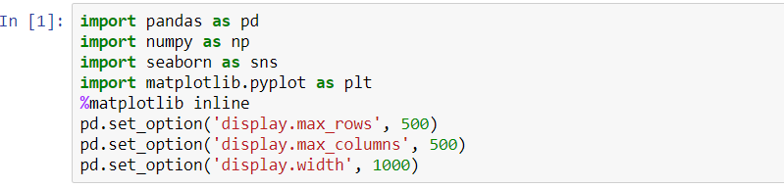
PREPROCESSING OF DATA:- 1.importing libraries 2.loading and describing the data 3.Removing insignificant columns. 4 Checking missing values for each columns
Import relevant libraries:- Standard libraries of Pandas and Numpy are imported, along with visualisation libraries of Matplotlib and seaborn.

Slide 7
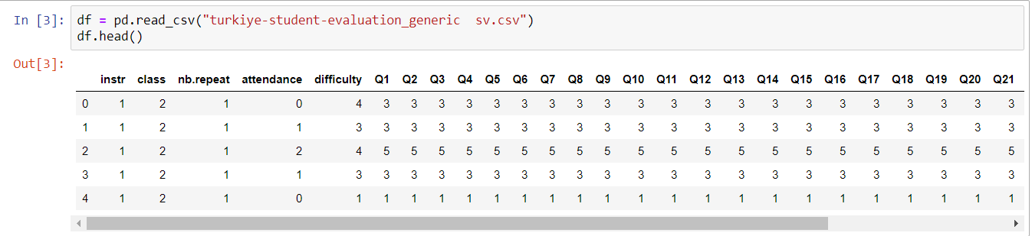
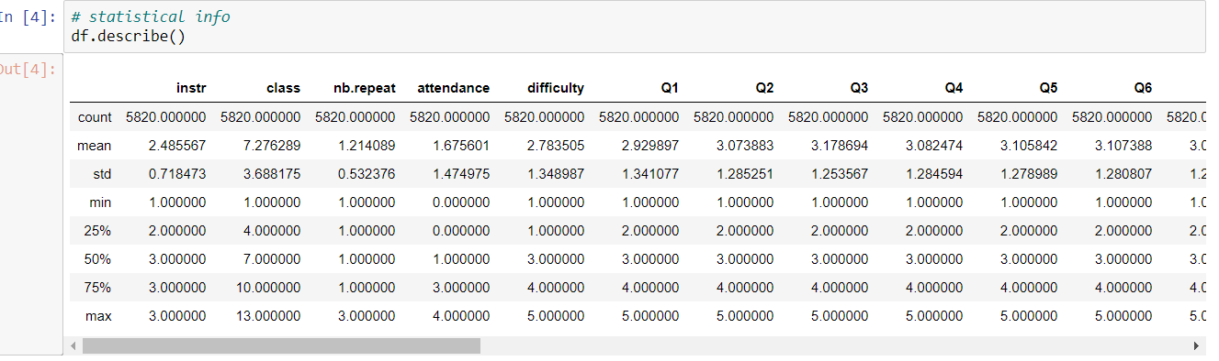
Dataset loading and preprocessing of data

Slide 8
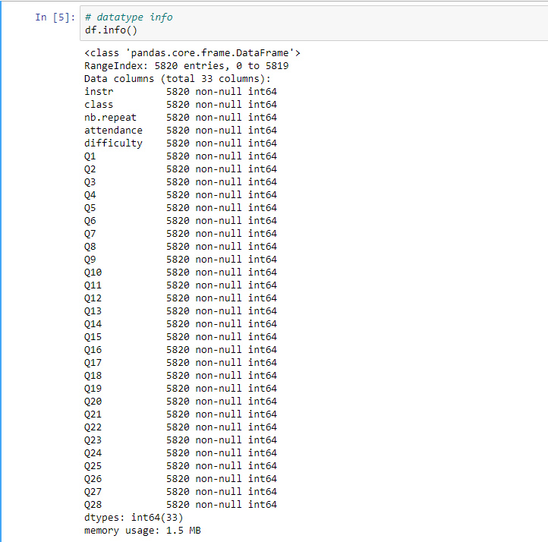
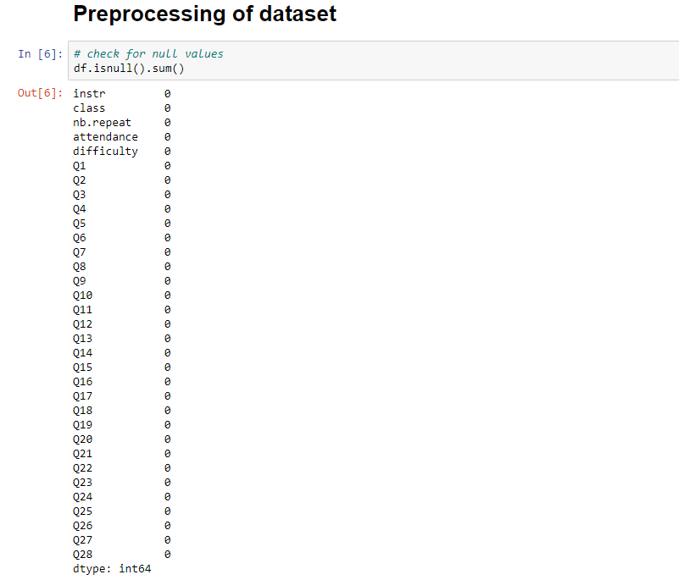

Slide 9
Exploratory data analysis

